Slide 1
Introduction to
Probability and Statistics
Instructor: Junni Zhang (张俊妮)
Phone: 62757922
Email: zjn@gsm.pku.edu.cn
Office: Room 473,
Guanghua Building No. 2
TA: Xuan Liang (梁萱)
Phone: 18811462893
Email: liangxuan@pku.edu.cn
TA: Jingchen Liu (刘靓晨)
Phone: 18610840532
Email: liujingchen@pku.edu.cn

Slide 2
Lecture Notes
Textbook
  Morris H. DeGroot and Mark Schervish (2001), Probability and Statistics, Addison Wesley, 3rd edition.
  Probability and Statistics, Revised Edition by Xiangzhong Fang, Ligang Lu, Dongfeng Li, Higher Education Press, 2005.
References
  John A. Rice (1994), Mathematical Statistics and Data Analysis, 2nd edition, Duxbury Press.
  陈家鼎等 (1993)，《数理统计学讲义》，高等教育出版社。
  戴维 R. 安德森，丹尼斯 J. 斯维尼，托马斯 A. 威廉斯 著，张建华等译，《商务与经济统计》，机械工业出版社。

Slide 3
Composition of Final Score
30% Individual Weekly Homework
  Your lowest homework score will be dropped when computing your final homework grade.
10% Team Project
30% Individual Midterm exam
30% Individual Final Exam

Slide 4
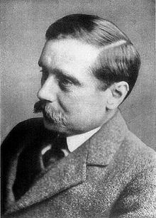
Quote 1
  “Statistical thinking will one day be as necessary as the ability to read and write.”
  — H.G. Wells, author of The Time Machine

Slide 5

Quote 2
  “I keep saying that the sexy job in the next 10 years will be statisticians, and I'm not kidding.”
  — Hal Varian, chief economist at Google.

Slide 6
Data: 2009/2010 Survey of peasant workers in Beijing
Education | Number of Household Members | Insurance | Contract | Monthly Household Income | Monthly Household Consumption
教育 | 家庭 人口数 | 社会保险 | 用工 合同 | 家庭月收入 | 家庭月消费
2 | 2 | 0 | 0 | 89000 | 300
2 | 4 | 0 | 0 | 35000 | 400
1 | 5 | 0 | 0 | 3200 | 50
3 | 3 | 0 | 0 | 21000 | 350
1 | 4 | 0 | 0 | 40000 | 750
3 | 3 | 0 | 0 | 1500 | 30
4 | 4 | 0 | 0 | 34000 | 1000
3 | 6 | 0 | 1 | 4600 | 200
... | ... | ... | ... | ... | ...
an observation
Education (教育): 0=no education (未受教育), 1=primary school (小学),
  2=middle school (初中), 3=high school (高中),
4=junior college (专科), 5=college (本科)
Notes:
dfghdfghfdghgfhdfghdfgh

Slide 7
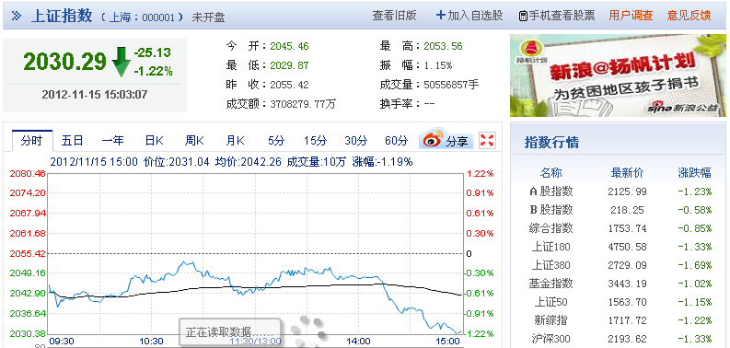
Data: Shanghai Composite Index

Slide 8

Data: JD.Com

Slide 9

Data: Weibo

Slide 10
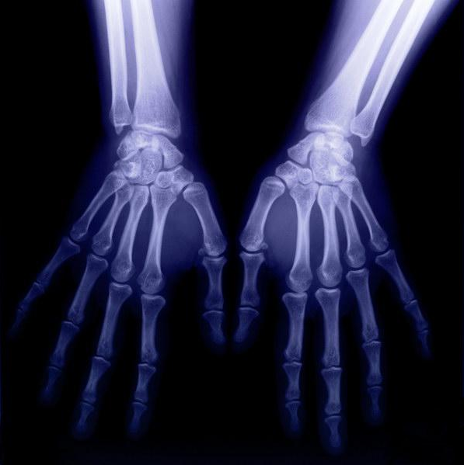
Data: Medical Image

Slide 11
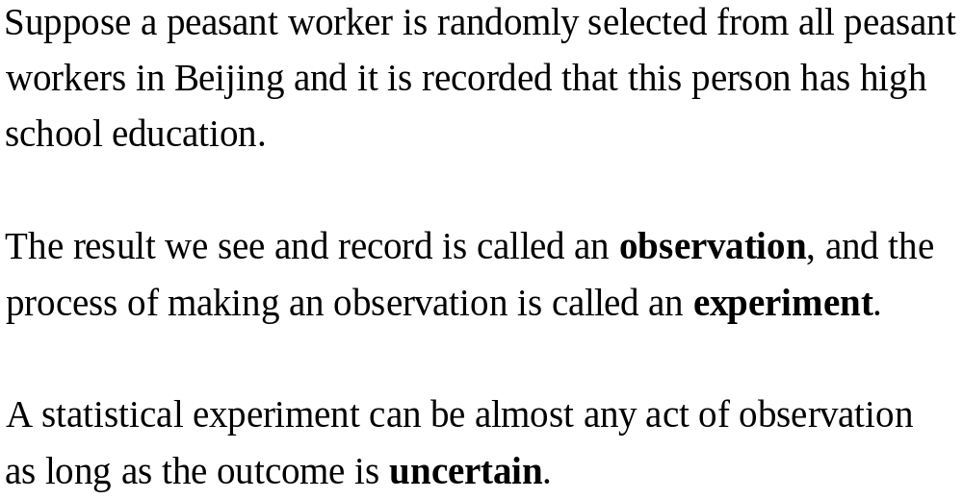
Experiment

Slide 12
Experiment
Consider the experiment of recording the educational level for a randomly selected peasant worker in Beijing. The basic possible outcomes of this experiment are 0,1, 2, 3, 4, 5.

Slide 13
Sample Point, Sample Space, Event
A basic possible outcome of an experiment is called a sample point (样本点).
The sample space (样本空间) for an experiment is the set of all sample points.
An event (事件) is a specific collection of sample points.

Slide 14
Experiment | Sample Space | Event
The Shanghai Composition Index at 15:00 on 2012-11-15. | [0, ∞] | The value of the index is smaller than 2040.
Whether there is a discount for a product at JD.com. | {Yes, No} | Yes
The number of fans for a Weibo account. | {0, 1, 2, …} | The number of fans is larger than 5,000.
The red/green/blue value at pixel (50,100) in a medical image. | {0, 1, 2, …, 255} | The red value is equal to 0.

Slide 15
Probability as Numerical Measure of Uncertainty
Probability is a numerical measure of the likelihood that an event will occur.
Probabilities could be used as measures of the degree of uncertainty.

Slide 16
The KP&L Problem
KP&L company is starting a project designed to increase the generating capacity of one of its plants. The project is divided into two sequential stages: stage 1 (design) and stage 2 (construction). Management cannot predict beforehand the exact time required to complete each stage of the project. An analysis of similar construction projects has shown completion times for the design stage of 2, 3, or 4 months and completion times for the construction stage of 6, 7, or 8 months.
Because of the critical need for additional electrical power, management has set a goal of 10 months for the completion of the entire project, and management wants to know the probability that the project will be finished on time.

Slide 17
Sample Space for the KP&L Problem
There are (3)(3)=9 outcomes in the sample space.
Completion Time (months)
Stage 1 Stage 2 Total Project
(Design) (Construction) Experimental Outcome Completion Time
2 6 (2,6) 8
2 7 (2,7) 9
2 8 (2,8) 10
3 6 (3,6) 9
3 7 (3,7) 10
3 8 (3,8) 11
4 6 (4,6) 10
4 7 (4,7) 11
4 8 (4,8) 12

Slide 18
Probabilities
Probability can be interpreted as the relative frequency of the occurrence of an event if the experiment is repeated a large number of times.
The KP&L problem:
Completion Time (months) Number of Past Projects With
Stage 1 Stage 2 Outcome Total Time These Completion Times Probability
2 6 (2,6) 8 6 6/40= .15
2 7 (2,7) 9 6 6/40= .15
2 8 (2,8) 10 2 2/40= .05
3 6 (3,6) 9 4 4/40= .10
3 7 (3,7) 10 8 8/40= .20
3 8 (3,8) 11 2 2/40= .05
4 6 (4,6) 10 2 2/40= .05
4 7 (4,7) 11 4 4/40= .10
4 8 (4,8) 12 6 6/40= .15
Total 40 Total 1.00
The probability of the project being finished on time is
.15+.15+.05+.10+.20+.05=.70

Slide 19
1.4 Set Theory
Probability Theory | Set Theory
sample space of an experiment e.g. the educational level for a randomly selected peasant worker in Beijing | the set of all possible outcomes S S={0,1,2,3,4,5}
an outcome (a sample point) e.g. high school education | an element in the set S 3
an event e.g. at least high school education | a subset of possible outcomes in S A={3, 4, 5}

Slide 20




Relations of Set Theory
An outcome s is a member of S
Event A is contained in event B: every outcome that belongs to the subset defining A also belongs to the subset defining B
Empty set: the subset that contains no outcomes

Slide 21
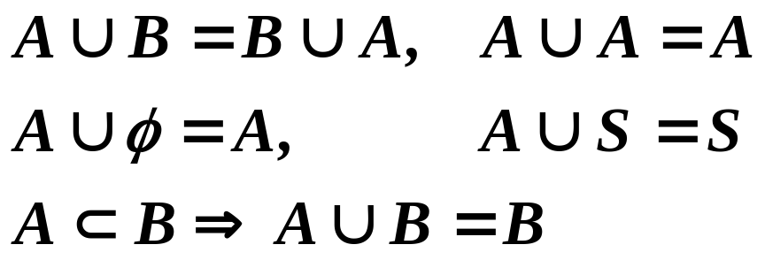
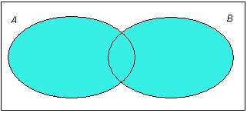
Operations of Set Theory
Unions. The union of A and B is defined to be the event containing all outcomes that belong to either A or B, or the event that either A or B would occur.

Slide 22
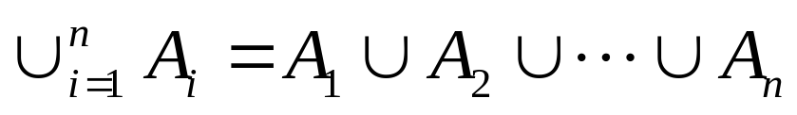

Some Notation
the union of n events is defined to be the event which contains all outcomes that belong to at least one of these n events, or the event that at least one of these n events would occur.
the union of an infinite sequence of events.

Slide 23
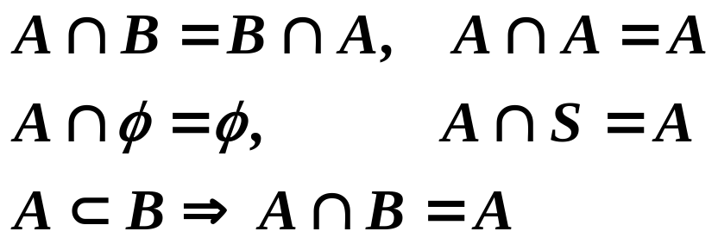
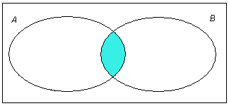
Intersections. The intersection of A and B is defined to be the event containing all outcomes that belong both to A and B, or the event that both A and B would occur.

Slide 24
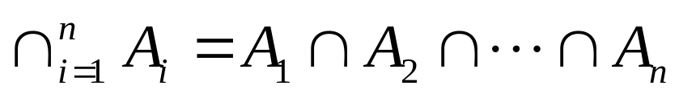

Some Notation
the intersection of n events is defined to be the event which contains all outcomes that are common to all these n events, or the event that all these n events would occur.
the intersection of an infinite sequence of events.

Slide 25
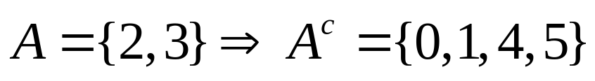

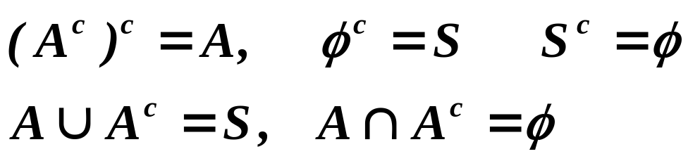
Complements. The complement of A is defined to be the event containing all outcomes in S that do not belong to A, or the event that event A would not occur.
e.g.

Slide 26


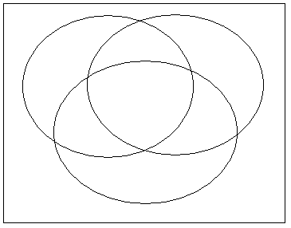











Disjoint events. A and B are disjoint, or mutually exclusive, if they have no outcomes in common.
e.g.
e.g. partition of the sample space into eight disjoint events according to three events A1, A2, A3

Slide 27


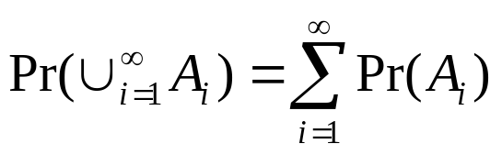
1.5 Definition of Probability
Need to assign to each event A a number Pr(A) indicating the probability of A.
  Axiom 1. For any event A,
  Axiom 2.
  Axiom 3. For every infinite sequence of disjoint events A1, A2, ...

Slide 28
Probability Distribution
A probability distribution on a sample space
S is a specification of numbers Pr(A) which
satisfy Axioms 1, 2, and 3.

Slide 29


Theorem 1.5.1
Theorem 1.5.2 For any finite sequence of disjoint events A1, ..., An,

Slide 30


Theorem 1.5.3 For any event A,
Theorem 1.5.4 For any event A,

Slide 31


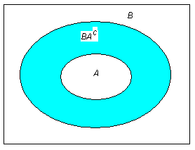
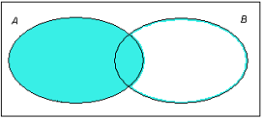
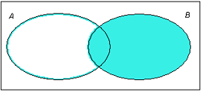
Theorem 1.5.5 If , then
Theorem 1.5.6 For any two events A and B,
+

